Slide 1

ACE
Engineering College
An Autonomous Institution
Ankushapur (V), Ghatkesar (M), Medchal Dist. – 501 301
DEPARTMENT OF CSE(ARTIFICIAL INTELLIGENCE & MACHINE LEARNING)
“A Hybrid Quantum-Classical Framework for Intelligent Load Balancing”
UNDER THE GUIDANCE OF TEAM MEMBERS:
Mrs. B. Suvidha Mohammad Sohail Hussain (23AG1A6643)
Assistant Professor Kotha Shiva Dhaneesh (23AG1A6636)
Kasiraju Dhatri Nandini (23AG1A6630)
vj

Slide 2
INTRODUCTION
Modern distributed systems and cloud environments handle a large volume of user requests, making efficient load balancing essential for maintaining system performance and reliability. Traditional load balancing techniques often fail to adapt to real-time changes in server conditions, leading to inefficient resource utilization and increased response time.
To overcome these challenges, intelligent load balancing systems are required that can dynamically analyze server conditions and make optimal decisions. The proposed system uses a hybrid quantum-classical approach to improve server selection and traffic distribution in real time.

Slide 3
ABSTRACT
This project presents an intelligent load balancing system based on a hybrid quantum-classical framework to efficiently distribute incoming requests across multiple servers. The system continuously monitors server parameters such as load, response time, and capacity, and applies a quantum-inspired optimization model to select the most optimal server.
The system also incorporates queue management to handle overload conditions and ensures fault tolerance. An interactive dashboard provides real-time visualization of system performance, including server status, load distribution, and request logs. The proposed system improves efficiency, reduces latency, and enhances reliability in distributed environments.
Technologies: Python, Flask, HTML, CSS, JavaScript, Chart.js Keywords: Load Balancing, Distributed Systems, Optimization, Server Monitoring, Queue Management

Slide 4
LITERATURE REVIEW
Literature Survey – Paper 1
Title: Dynamic Load Balancing in Cloud Computing Using Machine Learning Authors: S. Kumar, D. Patel Journal: International Journal of Cloud Computing (Scopus Indexed) Year: 2022
Problem Defined: Traditional load balancing techniques fail to adapt to dynamic workloads, leading to inefficient resource utilization and increased response time in cloud environments.
Method / Approach: Uses machine learning models to predict server load Applies dynamic decision-making based on real-time data Utilizes historical workload patterns for optimization.
Key Findings: Improves load distribution efficiency Reduces response time Enhances system scalability and adaptability.
Research Gap Identified: Requires large datasets for training Limited real-time adaptability in highly dynamic environments.

Slide 5
Literature Survey – Paper 2
Title: A Survey on Load Balancing Algorithms in Distributed Systems Authors: R. Mishra, P. Dubey Journal: International Journal of Computer Science and Engineering (SCI Indexed) Year: 2021
Problem Defined: Existing load balancing algorithms lack flexibility and fail to handle real-time traffic fluctuations efficiently in distributed systems.
Method / Approach: Analyzes static and dynamic load balancing techniques Compares algorithms based on performance metrics such as throughput and latency Evaluates scalability and efficiency.
Key Findings: Dynamic algorithms outperform static ones Identifies limitations in existing approaches Highlights need for intelligent load balancing.
Research Gap Identified: Lack of hybrid approaches Limited focus on real-time optimization and adaptive systems.

Slide 6
Literature Survey – Paper 3
Title: Optimization Techniques for Resource Allocation in Distributed Systems Authors: J. Lee, H. Kim, S. Park Journal: IEEE Access (Scopus & SCI Indexed) Year: 2020
Problem Defined: Inefficient resource allocation leads to server overload and poor system performance in distributed environments.
Method / Approach: Applies optimization techniques such as Genetic Algorithms and Particle Swarm Optimization Evaluates multiple parameters for decision-making Focuses on minimizing latency and maximizing resource utilization.
Key Findings: Optimization algorithms improve system efficiency Enhances decision-making accuracy Reduces server overload.
Research Gap Identified: High computational complexity Not suitable for real-time applications without simplification.

Slide 7
Literature Survey – Paper 4
Title: Quantum-Inspired Optimization for Load Balancing Authors: Y. Zhang, X. Liu, L. Chen Journal: Journal of Computational Science (Scopus Indexed) Year: 2023
Problem Defined: Classical optimization techniques struggle to solve complex load balancing problems efficiently in large-scale systems.
Method / Approach: Uses quantum-inspired algorithms for solving optimization problems Simultaneously evaluates multiple possible solutions Applies probabilistic decision-making techniques.
Key Findings: Improves optimization efficiency Faster convergence compared to classical methods Suitable for complex distributed systems.
Research Gap Identified: Requires advanced computational models Limited real-world implementation and validation.

Slide 8
Literature Survey – Paper 5
Title: Intelligent Load Balancing Using Artificial Intelligence Authors: X. Chen, Y. Wang, Z. Li Journal: International Journal of Artificial Intelligence Research (Scopus Indexed) Year: 2022
Problem Defined: Traditional load balancing systems lack intelligence and cannot adapt to changing workloads and system conditions.
Method / Approach: Integrates AI techniques for decision-making Uses real-time monitoring and predictive analysis Applies intelligent routing mechanisms.
Key Findings: Enhances system performance and reliability Reduces latency and improves resource utilization Enables adaptive and intelligent systems.
Research Gap Identified: Complexity in implementation Requires continuous monitoring and data processing.

Slide 9
EXISTING SYSTEM
Approach: Traditional load balancing techniques such as Round Robin and Least Connections are used to distribute requests across servers.
Methods Used: Static and simple dynamic algorithms without real-time intelligence.
Process: Requests are distributed sequentially or based on simple metrics without considering multiple parameters.
Drawbacks: • Cannot adapt to real-time server conditions • Inefficient resource utilization • Higher response time • No fault tolerance mechanism • Limited scalability

Slide 10
PROPOSED SYSTEM
Approach: An intelligent system that uses real-time monitoring and quantum-inspired optimization to select the best server dynamically.
Methods: • Load monitoring • Weighted optimization model • Dynamic routing • Queue management
Process: User sends request → System monitors server parameters → Optimization algorithm selects best server → Request routed → Logs updated → Dashboard visualized
Advantages: • Efficient load distribution • Reduced response time • Real-time monitoring • Fault tolerance using queue • Scalable and adaptive

Slide 11
SYSTEM REQUIREMENTS
HARDWARE REQUIREMENTS
• Processor: Intel Core i3/i5 or above • RAM: Minimum 4 GB (8 GB recommended) • Storage: Minimum 10 GB • Network: Stable internet connection
SOFTWARE REQUIREMENTS
• Operating System: Windows 10 / 11 • Backend: Python (Flask) • Frontend: HTML, CSS, JavaScript • Libraries: Chart.js • Tools: VS Code, Git/GitHub

Slide 12
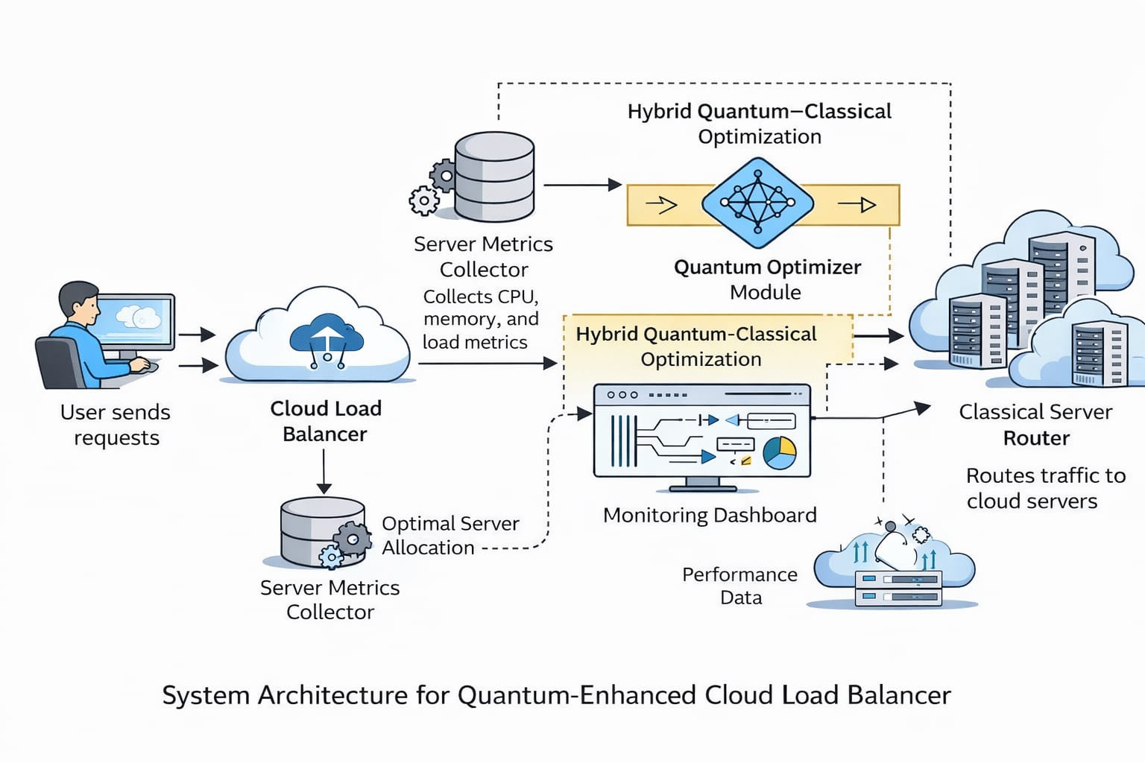
SYSTEM ARCHITECTURE

Slide 13
UML DIAGRAMS
UML diagrams help visualize a system – They show the structure and working of a system in a clear graphical form.
Used for planning software design – Developers use UML to understand components and relationships before coding.
Different types of UML diagrams exist – Examples include use case, class, sequence, and activity diagrams.
Improves communication – UML diagrams make it easier for team members to understand the system design.
Helps in documentation – They provide proper system documentation for future development and maintenance.

Slide 14
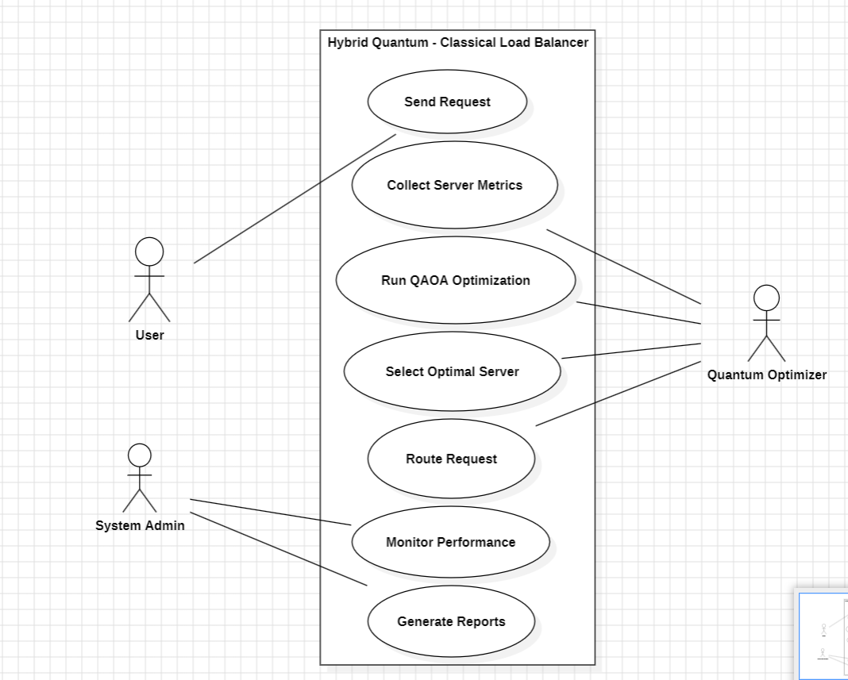
USE CASE DIAGRAM

Slide 15
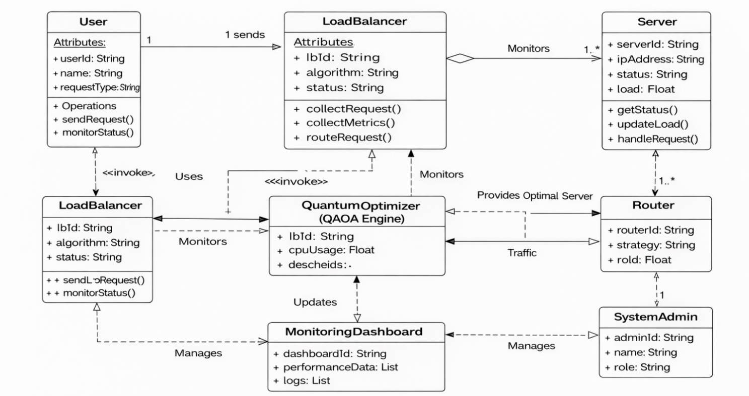
CLASS DIAGRAM

Slide 16
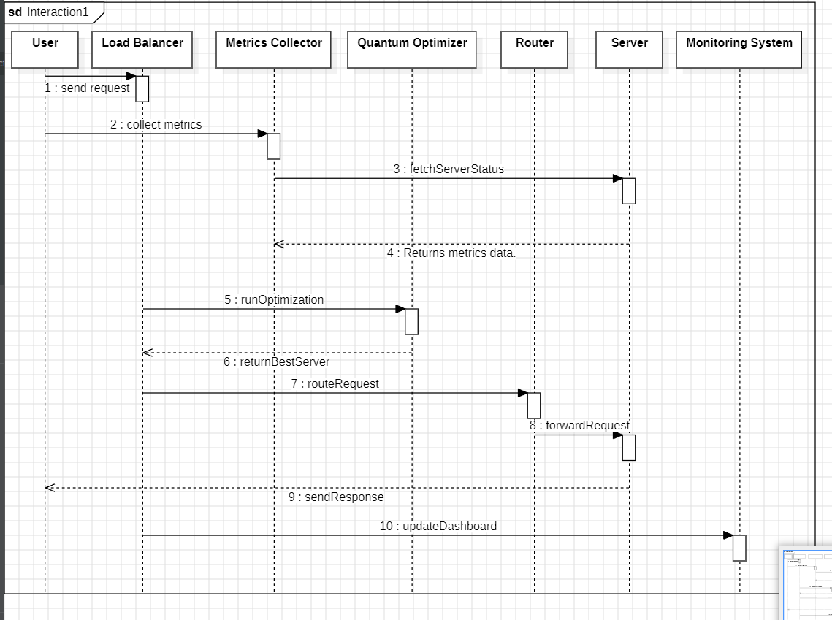
SEQUENCE DIAGRAM

Slide 17
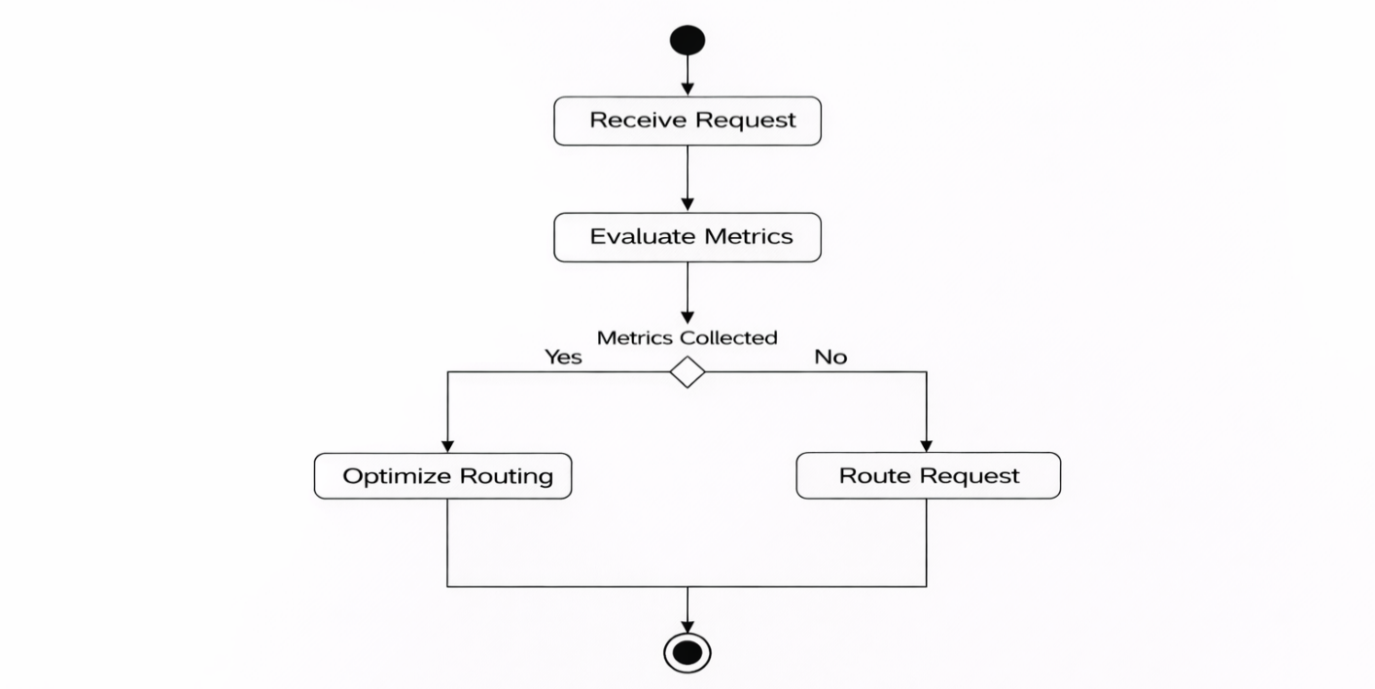
ACTIVITY DIAGRAM

Slide 18
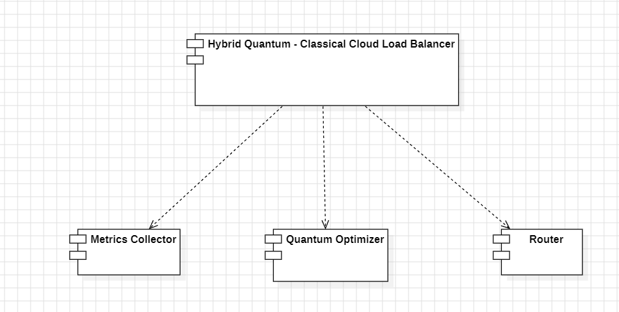
COMPONENT DIAGRAM

Slide 19
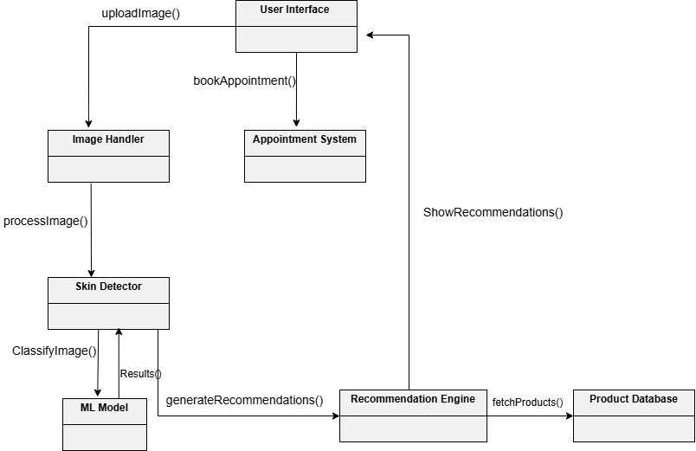
OBJECT DIAGRAM

Slide 20
CODE IMPLEMENTATION
Importing Required Libraries
The system begins by importing necessary libraries required for web development, data handling, and simulation.
from flask import Flask, render_template, jsonify import random import time
The Flask framework is used to create the web application, while the random module is used to simulate dynamic server conditions.
6.1.2 Initializing Flask Application
The Flask application is initialized to create the backend server.
app = Flask(__name__)
This object is used to define routes and manage the application.

Slide 21
6.1.3 Server Initialization
The system simulates multiple servers with different configurations such as capacity, type, and status.
servers = [ {"id": "Server1", "type": "High Performance", "capacity": 120, "status": "active"}, {"id": "Server2", "type": "Standard", "capacity": 100, "status": "active"}, {"id": "Server3", "type": "Edge", "capacity": 80, "status": "active"} ]
Each server is represented as a dictionary containing its properties.
6.1.4 Load Monitoring Function
This function dynamically updates server parameters such as load, response time, and status.
def get_metrics(): for server in servers: server["load"] = random.randint(10, 100) server["response_time"] = random.randint(50, 150) if server["load"] > 75: server["status"] = "down" elif server["load"] > 50: server["status"] = "busy" else: server["status"] = "active" return servers

Slide 22
6.1.5 Optimization Function
The optimization module selects the best server based on multiple parameters.
Def optimize_server(servers): active_servers = [s for s in servers if s["status"] != "down"] if not active_servers: return None def score(s): return 0.5 * s["load"] + 0.3 * s["response_time"] return min(active_servers, key=score)
This function ensures intelligent decision-making.

Slide 23
ALGORITHM
Data Collection and Preprocessing
The dataset consists of real-time server data collected from multiple servers in a distributed environment. The data includes parameters such as load percentage, response time, and number of requests. This data is continuously updated to simulate real-world system behavior. The preprocessing stage includes:
Data Cleaning: Removing invalid or missing values from server data.
Normalization: Standardizing load and response time values for fair comparison.
Feature Extraction: Selecting key parameters such as load, response time, and request count.
Noise Removal: Eliminating unnecessary fluctuations in data.
Storage: Processed data is stored in structured format for further analysis.

Slide 24
METHODOLOGY
The proposed system follows a structured approach to achieve intelligent load balancing by integrating real-time monitoring, optimization, and routing mechanisms. The methodology is designed to dynamically analyze server conditions and ensure efficient distribution of incoming requests.
Step 1: Request Generation
User requests are generated through the interface and sent to the backend system for processing.
Step 2: Load Monitoring
The system continuously monitors server parameters such as load percentage, response time, and number of active requests.
Step 3: Data Preprocessing
Collected server data is cleaned, normalized, and structured to ensure consistency. Key features such as load and response time are extracted for decision-making.
Step 4: Optimization (Server Selection)
A quantum-inspired weighted optimization algorithm is applied to evaluate all available servers. The system calculates a score based on load and response time and selects the server with the minimum score as the optimal server.
Step 5: Request Routing
The selected server receives the request, processes it, and returns the response. The system updates the request count and logs for tracking purposes.
Step 6: Queue Management
If all servers are overloaded, incoming requests are temporarily stored in a queue. These requests are processed when servers become available, ensuring no data loss.
Step 7: Visualization and Logging
The system updates the dashboard in real time, displaying server status, load distribution, and request logs through graphs and indicators.

Slide 25
WORKFLOW
The system processes user requests by monitoring server conditions and selecting the most suitable server for efficient load distribution.
Step 1: User sends request Step 2: Server data (load, response time) is updated Step 3: System evaluates all servers Step 4: Optimal server is selected Step 5: Request is processed Step 6: Queue handles overload (if any) Step 7: Output and dashboard updated

Slide 26
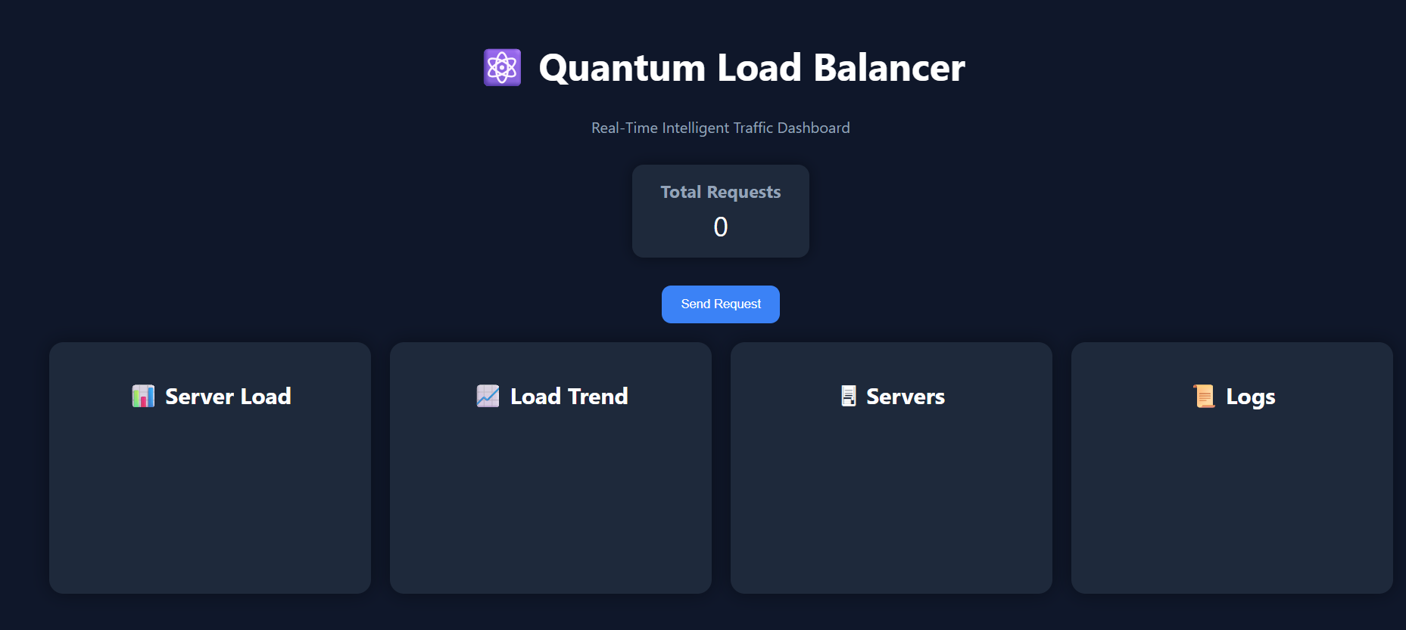
FINAL OUTPUT
Fig 6.1 Initial system state before request execution

Slide 27
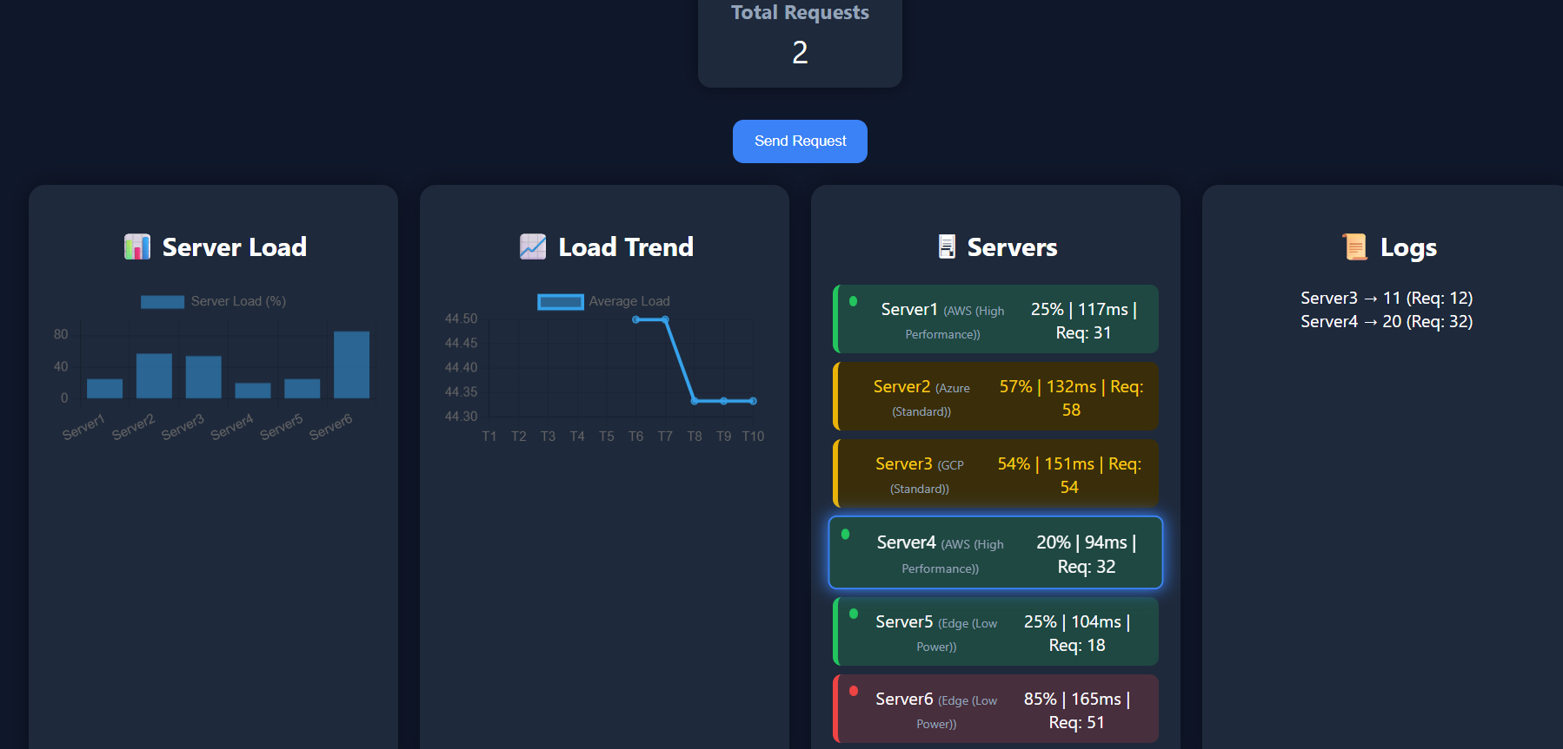
Fig 6.2 Request generation in the system

Slide 28
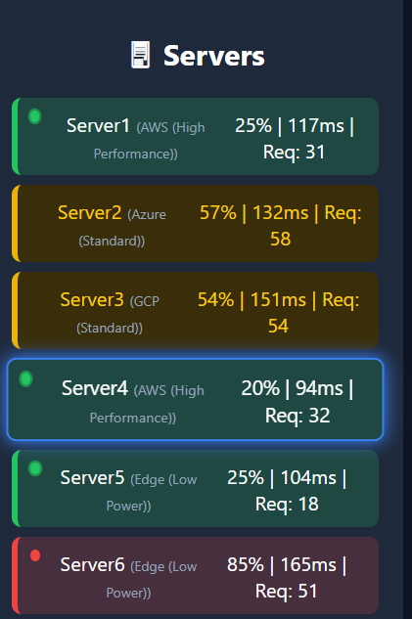
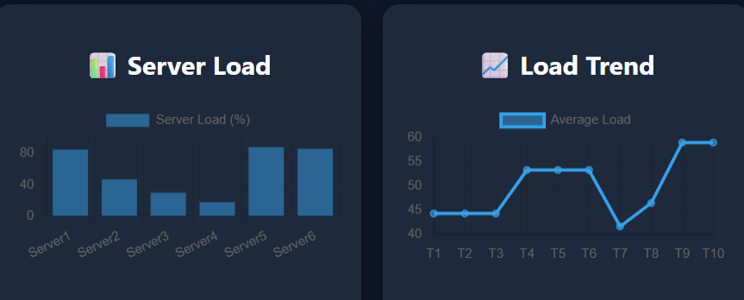
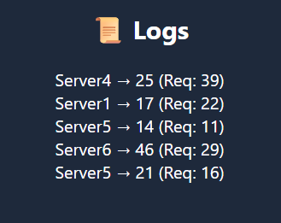
Fig 6.4 Graphical representation of server load distribution
Fig 6.3 Optimal server selected by the system
Fig 6.5 System logs showing request
routing details

Slide 29
THANK YOU

